Slide 1
RPA Project Report
Shubham Kaushik
2301418F | Class: P03

Slide 2
Problem statement
In the current business environment, managing and processing large volumes of customer data from various sources is a critical challenge. The need to effectively filter, organize, and utilize this data to drive targeted communications and business decisions is paramount. The existing process of handling customer data, from collection to engagement, is time-consuming, prone to errors, and lacks efficiency.
Our organization faces several challenges:
Data Integration: Customer data from initial interactions, such as product purchases and website visits, is currently managed through manual or semi-automated processes, leading to potential data inaccuracies and inefficiencies.
Data Segmentation: Differentiating between customers who have purchased products, those who visited but did not purchase, and those with incomplete information requires significant manual effort, increasing the risk of miscommunication and missed opportunities.
Automated Communication: The current method of sending targeted emails to customers based on their interaction history is not fully automated, resulting in delays and inconsistencies in customer engagement.
Data Analytics and Reporting: Extracting insights from web analytics to inform business decisions is labor-intensive, and the results are not seamlessly integrated into actionable formats.

Slide 3
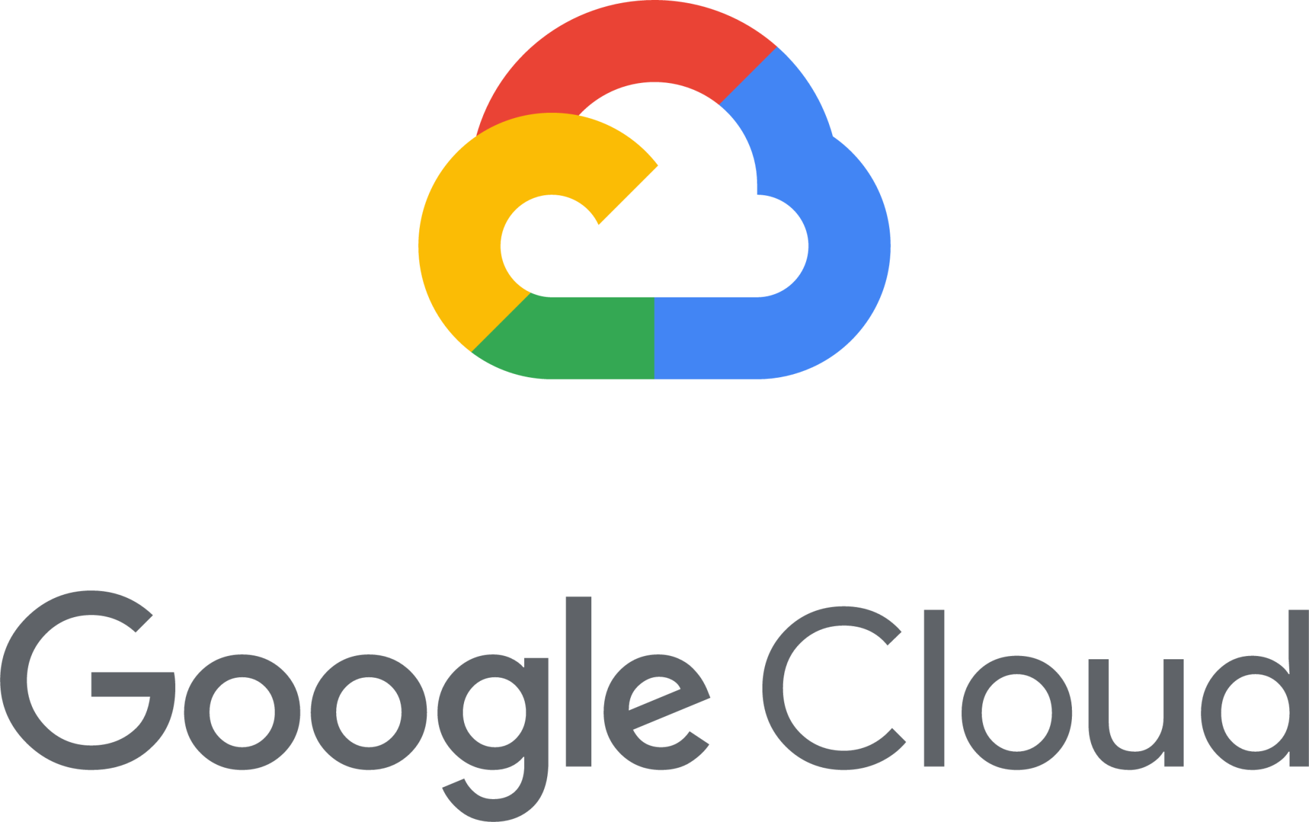

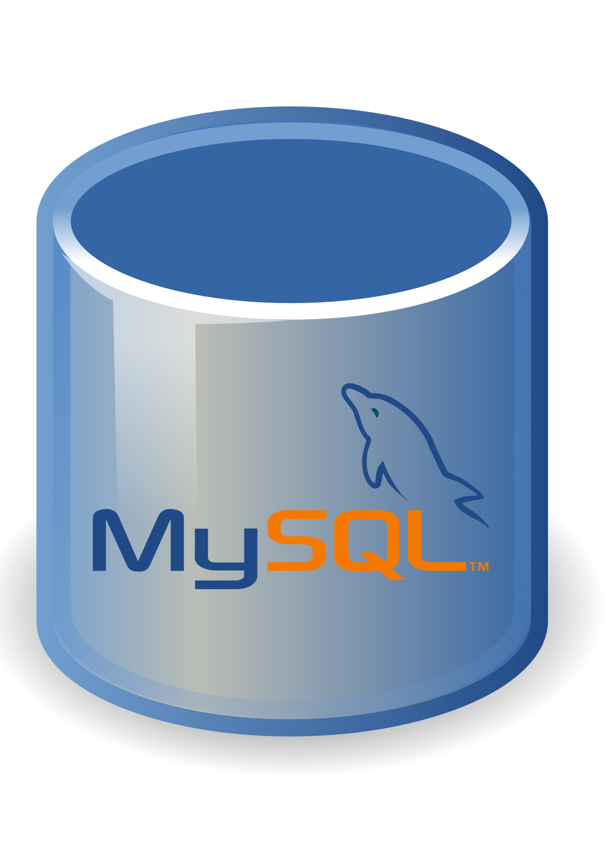


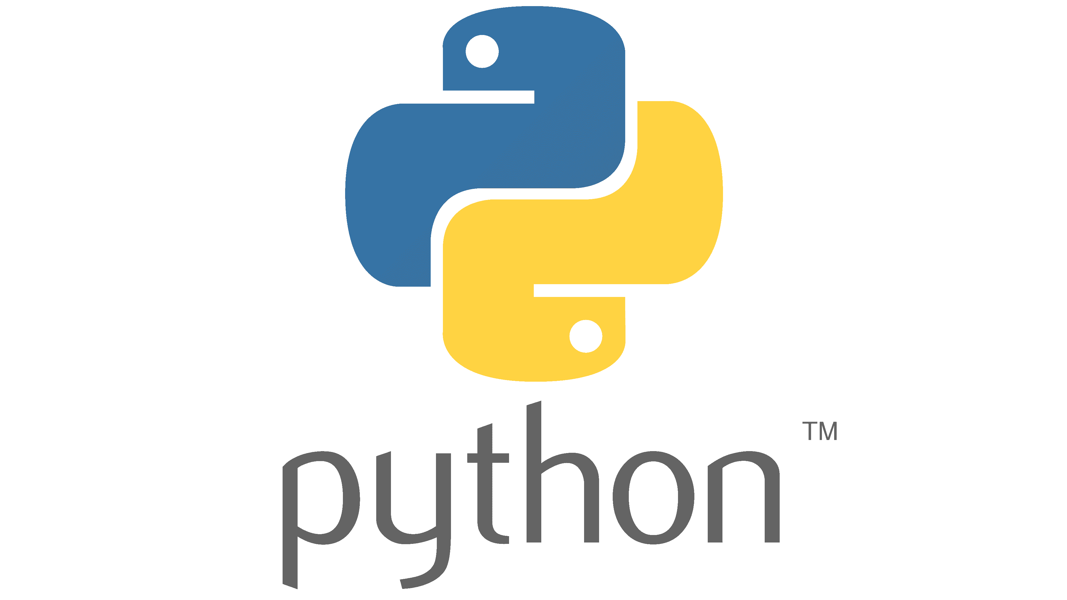


Process
Application Architecture
Step 1: All the data in MySQL is Selected as Data Table
The selected data is filtered, and RegEx characters are removed. This is cleaned data in MySQL.
Step 2: Select rows with missing values from the cleaned data in MySQL & transfer them to “missing_values.xlxs” excel file
Step 3: Select rows with customers who bought a product from the cleaned data in MySQL & transfer to “customers_did_purchase_product.xlsx” excel file. Send a personalized email to the individual's Outlook.
Step 4: Select rows with customers who did not buy a product from the cleaned data in MySQL & transfer them to “customers_did_not_purchase_product.xlsx” excel file. Send a personalized email to the individual's Outlook.
Step 5: Gather essential variables from the JSON file [downloaded from Google Cloud] which will be used to generate “jwt_token”
The essential variables were; clientEmail, privateKey, formattedKey, scope, tokenUri, jwt
Step 6: Using a Python script, a JSON Web Token[JWT] is generated.
Step 7: HTTP POST request is made to obtain the OAuth 2.0 access token from Google’s OAuth 2.0 authentication server.
Step 8: HTTP POST request is made to the Google Analytics Reporting API v4 to retrieve analytics data, using OAuth 2.0 authentication server.
Step 9: The data received from Google Analytics is in JSON. The data is collected into a DataTable, ‘dtAnalytics’ & the DataTable is then written into a notepad.
Notepad

Slide 4
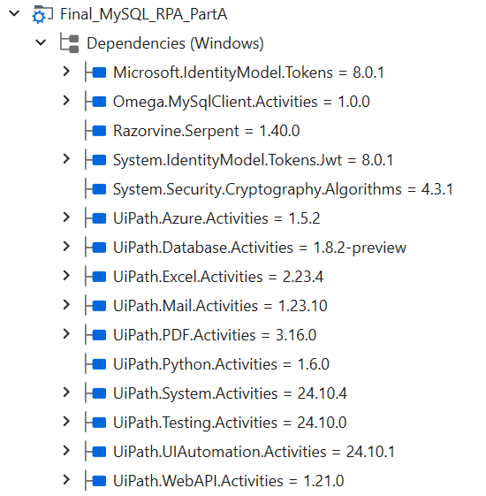
Packages used (Project Dependencies)
Microsoft.IdentityModel.Tokens = 8.0.1
Handles security tokens for authentication and authorization.
Omega.MySqlClient.Activities = 1.0.0
Lets you interact with MySQL databases (e.g., running queries).
Razorvine.Serpent = 1.40.0
Helps with serializing and deserializing Python objects.
System.IdentityModel.Tokens.Jwt = 8.0.1
Manages JWT (JSON Web Tokens) for secure communication.
System.Security.Cryptography.Algorithms = 4.3.1
Provides tools for encryption and cryptographic operations.
UiPath.Azure.Activities = 1.5.2
Allows you to automate tasks involving Microsoft Azure services.
UiPath.Database.Activities = 1.8.2-preview
Enables database operations like reading and writing data.
UiPath.Excel.Activities = 2.23.4
Automates tasks in Excel, such as reading and writing data.
UiPath.Mail.Activities = 1.23.10
Manages email tasks, like sending and receiving emails.
UiPath.PDF.Activities = 3.16.0
Handles PDF files, including reading, merging, and splitting.
UiPath.Python.Activities = 1.6.0
Integrates Python scripts into your UiPath workflows.
UiPath.System.Activities = 24.10.4
Provides basic automation tasks like file handling and workflow control.
UiPath.Testing.Activities = 24.10.0
Supports automated testing within your RPA processes.
UiPath.UIAutomation.Activities = 24.10.1
Automates interactions with user interfaces (e.g., clicking, typing).
UiPath.WebAPI.Activities = 1.21.0
Enables communication with web APIs (e.g., sending HTTP requests).

Slide 5
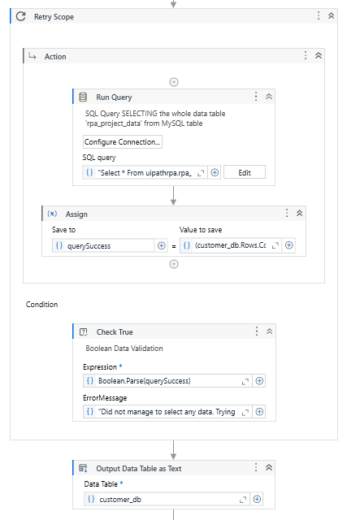
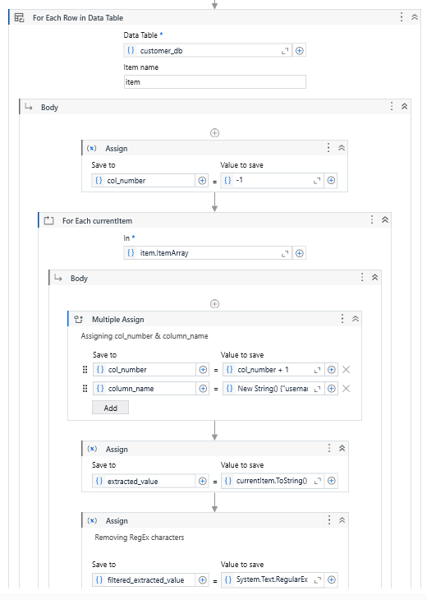
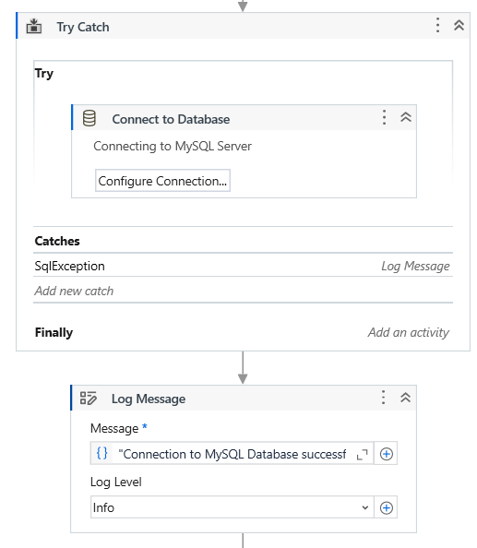
Details of solution
The bot connects My SQL using the “Connect to Database” activity.
If there is an issue with connecting with MySQL server then an SQLException error is raised and passed as a message box.
This connection later ended when I was done using MySQL
3 Excel sheets are made after the cleaning data using the SELECT sql query.
The 3 files contain rows/customers who have missing values, who bought at least one product, and customer who did not buy a product (meaning the customer only visited the website)
The data in MySQL is unsuitable to be used due to RegEx characters that may cause errors when handling the data (e.g. when sending an email, the name may contain RegEx character.)
The data table containing the current uncleaned data ’customer_db’ is then passed into the activity “For Each Row in Data Table”.
Using activities such as For Each, multiple assign, etc, while using code such as, “System.Text.RegularExpressions.Regex.Replace(extracted_value, "[^\w]", "")” successfully allowed me to remove RegEx characters and clean the data

Slide 6
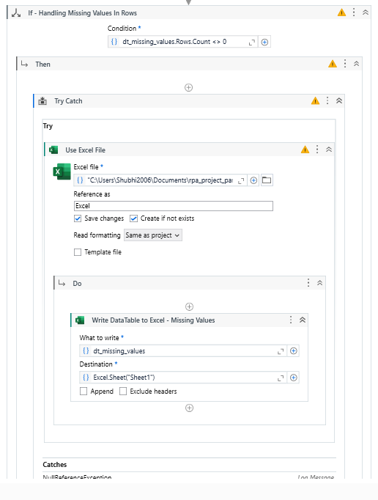
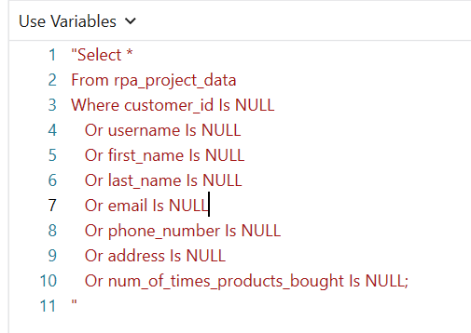
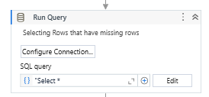
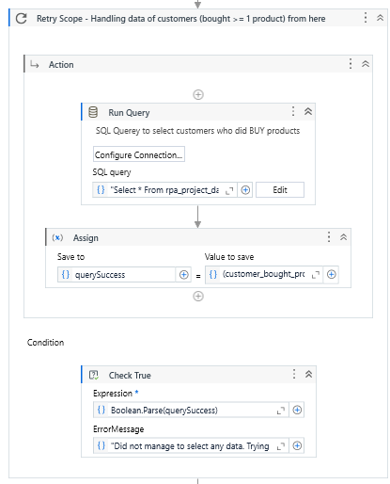
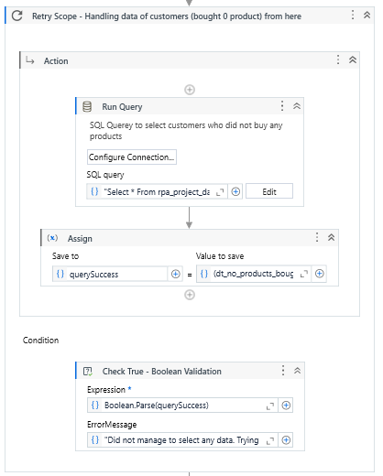
Used this “Run Query” activity to select all rows that have missing values (e.g a data point with missing name of the customer)
This is the Select query for missing values
This “Use Excel File” Activity is used for writing the data selected from the “Run Query” activity.
The “Use Excel File” Activity only runs when “If” activity is True (Boolean Value)
If there is an error in using the file “NullReferenceException” the error would be caught
Selecting customers who bought products from our website & Selecting customers who did not purchase any products from our website.
I used Retry Scope activity, in which I used Boolean validation to check if the sql query has been successful
If the query was not successful in that case, the user would see the Error Message and the bot will retry the SQL query again

Slide 7
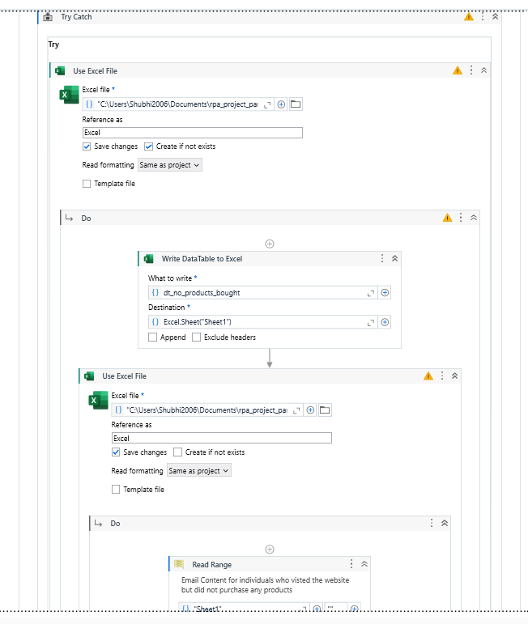
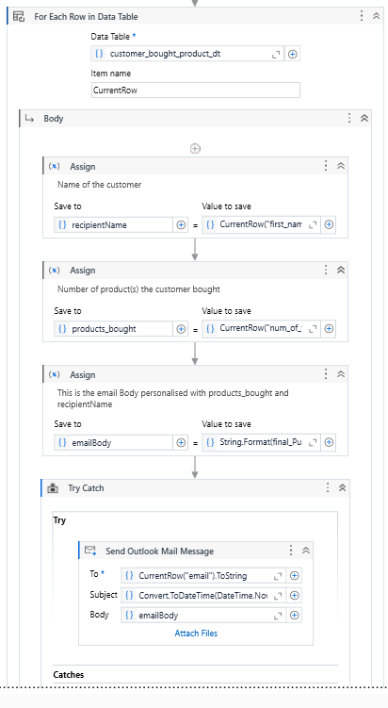
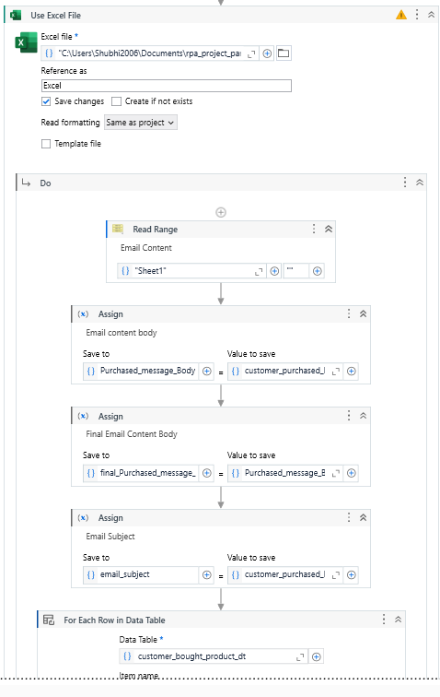
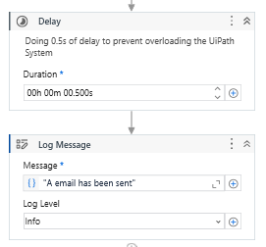
Using the “Use Excel File” activity, I was able to transfer the data of customers who did not buy the product
Within in the “Use Excel File” activity” there is another “Use Excel File” activity.
The second “Use Excel File” activity is used to copy the email content(e.g email content & email subject) for “customers who did not purchase the products”
The email content contains {0} & {1} to replace the name of the customer & the number of products bought
The variable such as “recipient name”, “products_bought” & “emailBody” are going to be used for the activity “Send Outlook Mail Message”
These exact steps are repeated for customer who bought the product.
But the emailBody sent is different for them.
This is the “User Excel File” activity within the first “User Excel File” activity
After the email is send Delay activity is used to prevent the overloading the UiPath System and prevent any errors from occurring

Slide 8
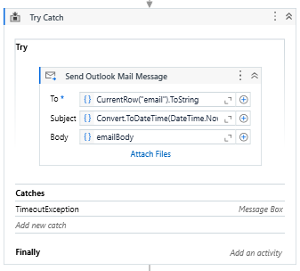
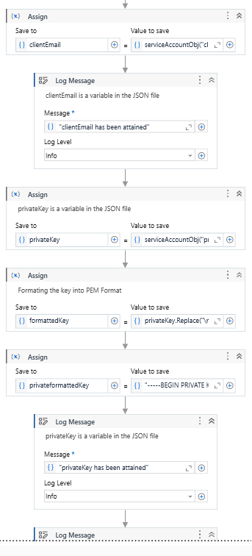
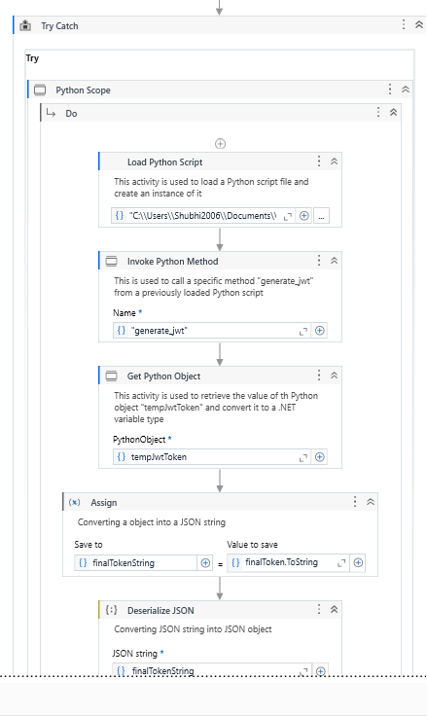
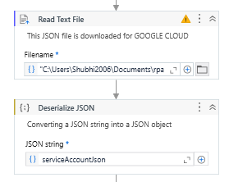
When sending the Outlook email. Outlook will give an error of TimeOutException.
If you get that error “Try Catch” activity will catch that error and show the issue in a message box
Having sent all of my customers a personalised email. I use “Read Text File” activity to read the JSON file
The JSON file was downloaded from Google Cloud when creating a Google API for my website.
The JSON file is then Deserialized using “Deserialized JSON” activity. This activity is used to convert a JSON string into a structured object that UiPath can work with easily.
I used the Python Scope activity is used to integrate and execute Python scripts with my UiPath workflow.
“Load Python Script” activity is used to load the code from the filepath into UiPath’s memory which can be later on excuted
In the “Invoke Python Method” activity, I have passed these variable [clientEmail, privateKey, formattedKey, scope, tokenUri, jwt] as arguments under “Input Parameter”
Using “Get Python Object” I get my tempJwtToken.
I convert tempJwtToken into a string and then deserialize the JSON string
Using the JSON file, I created variables; clientEmail, privateKey, formattedKey, scope, tokenUri, jwt
The JSON file contains these variables and they will be used to generate JSON Web Token[JWT].

Slide 9
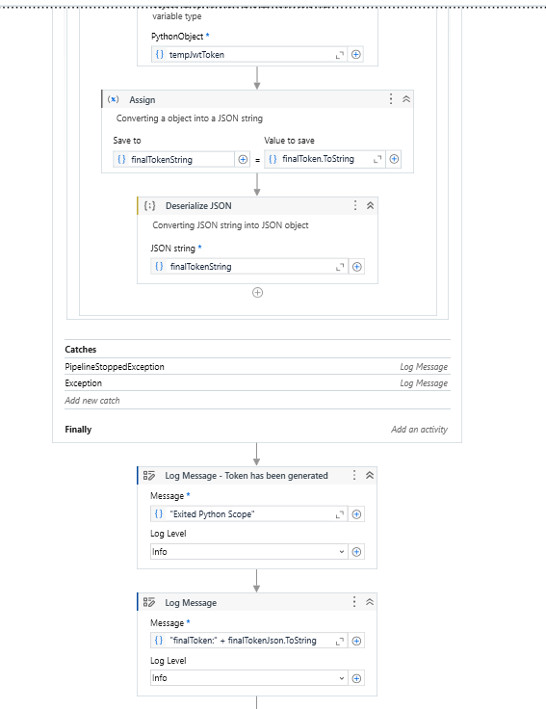
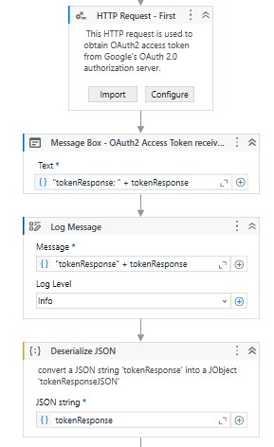
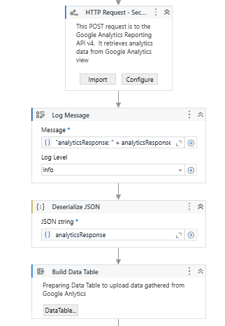
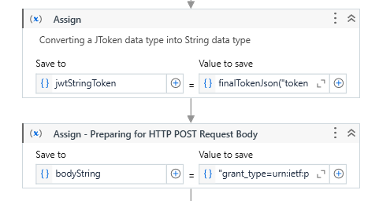
My “Python Scope” activity is in the “Try Catch” activity
When running the activity “Python Scope” it is often for developers to get the error of PipelineStoppedException.
In this error, the UiPath stops at “Python Scope” activity and is not able to enter the scope to run the Python-related activities
The error that you receive would be a log message
I added another error catch for exception, it would be displayed as a log message as well.
After exiting, the python scope, the ‘finalToken’ would be logged
bodyString = "grant_type=urn:ietf:params:oauth:grant-type:jwt-bearer&assertion=" + jwtStringToken
grant_type indicates the type of OAuth 2.0 grant being used.
[urn:ietf:params:oauth:grant-type:jwt-bearer&assertion] signifies that the JWT(JSON WEB TOKEN) bearer grant is being used. This allows the client to exchange a JWT for an access token
The purpose of the first HTTP request is to obtain OAuth2 access token
HTTP request is made using the “HTTP Request” activity.
In this activity, the variable body string is used as the body of the request
The body format of the request was ‘Form-UrlEncoded’
The output variable is “tokenResponse”. This variable is the OAuth2 access token from Google’s Oauth 2.0 authorization server
This is my “token response”
The second HTTP request is made to Google Analytics Reporting API v4. It retrieves analytics data from the Google Analytics view
“tokenResponse” from the first HTTP request is being used as authorization to get the data of our website from the Google Analytics API v4
The body format was: ‘application/json’
The body content was ["{""reportRequests"": [{""viewId"": ""314533824"",""dateRanges"": [{""startDate"": ""30daysAgo"",""endDate"": ""today""}],""metrics"": [{""expression"": ""ga:sessions""}],""dimensions"": [{""name"": ""ga:country""}]}]}"]
The output of the HTTP request was “analyticsResponse”

Slide 10
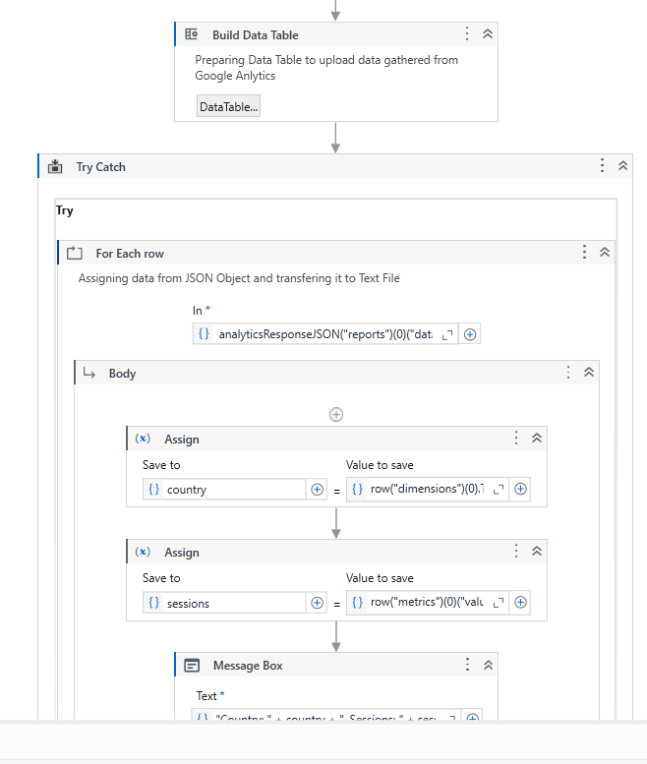
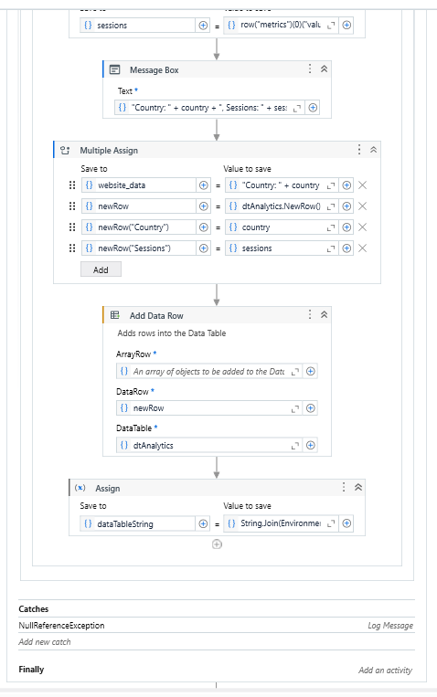
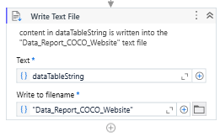
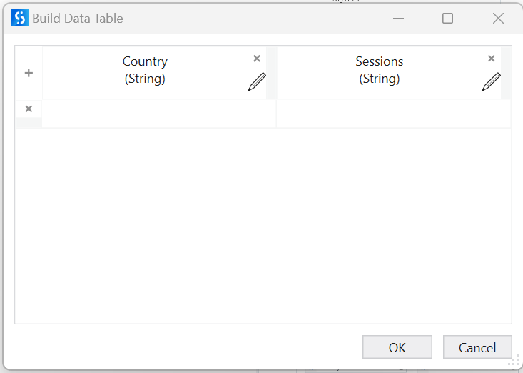
Using the activity “For Each Row”, I was able to assgin the data from that I have previously gotten in “analyticsResponse” by each row
I also used the “Multiple Assign” activity to create my own function called “newRow()”
Using “Add Data Row” activity, I was able to add the rows of the data into the datatable
Using the “Try Catch” activity I was able to catch any NullReferenceException as a Log message
After getting the data from Google Analytics API
I created my own DataTable and named it “dtAnalytics”
Continues from here
After all the data from the Google Analytics API has been transferred into the DataTable.
I used the “Write Text File” activity to write the data into a motepad
These are the columns in the DataTable that I created

Slide 11
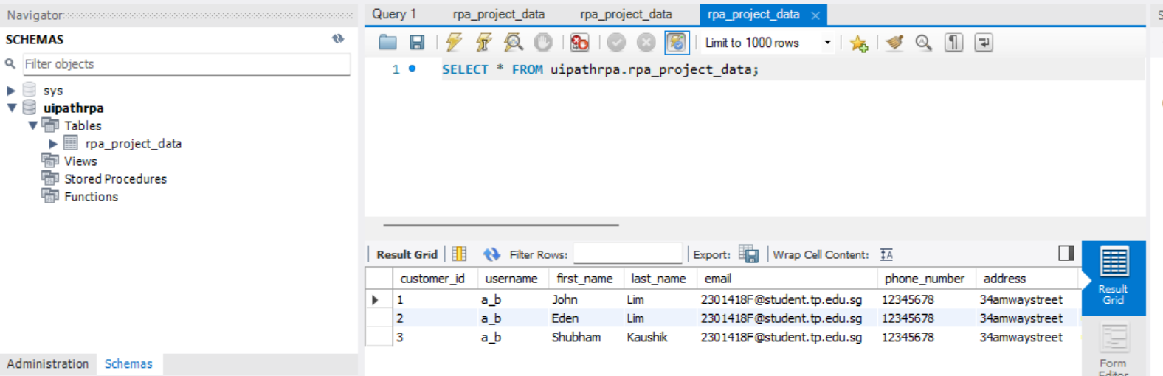
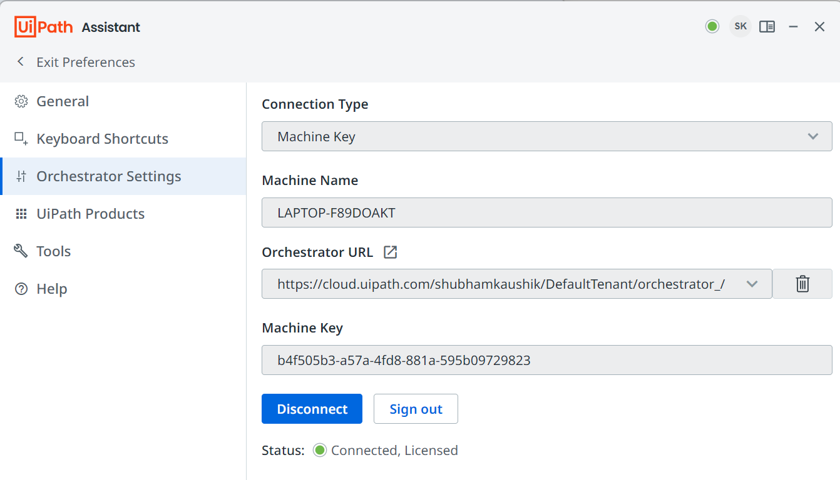
MySQL Table
uipath orchestrator
yOUtube LINK: https://youtu.be/iRxEnLmkYiw

